Slide 1
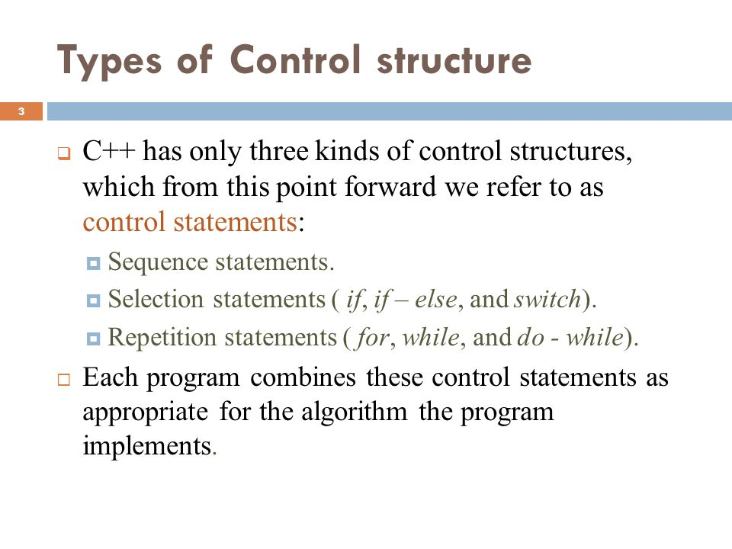

Slide 2

CONDITIONAL
STRUCTURE
IN C++
.

Slide 3
INTRODUCTION
Conditional statement are used to execute a set of statements on some conditions. It provide a unit of block in which we can either one statement or more than one statements.

Slide 4
If the given condition is true than the set of statement are executed otherwise body is skipped….

Slide 5
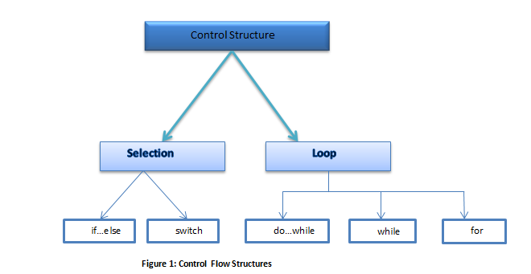

Slide 6
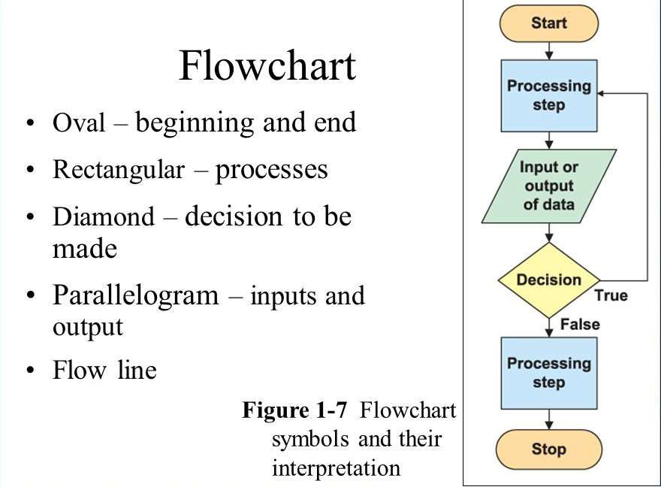

Slide 7
IF CONDITION
It is conditional statement, which is used to execute a set of statement on some conditions. The condition must be of “boolean” type

Slide 8
An expression, which returns only two value either true or false, is known as boolean type expression.

Slide 9
SYNTAX:
The syntax of if statement is as follows: if(condition)
Statement;
The above syntax is used for single statement. A set of statement can also be made conditional.

Slide 10
In this case, these statement are written in curly braces. The set of statements is also called compound statement.
The syntax for compound statements in if statement is as follows:
If(condition)
{
Statement 1;

Slide 11
Statement 2;
Statement 3;
Statement 4;
.
.
.
Statement n;
}

Slide 12
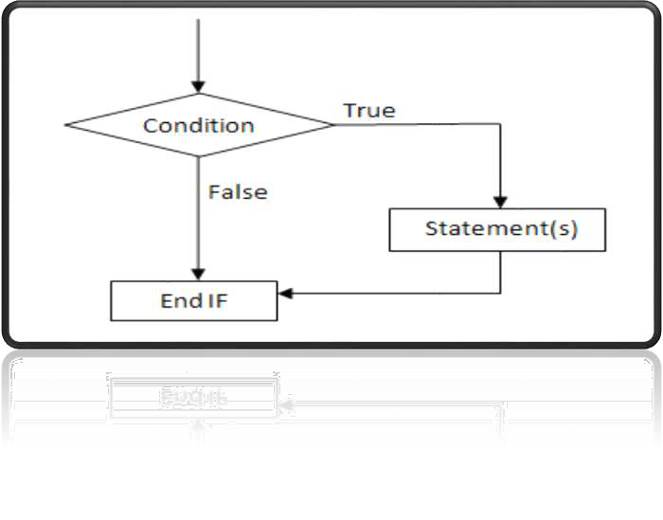

Slide 13
EXAMPLE:
Write a program that inputs two numbers and finds whether both are
Equal.
#Include <iostream.H> #include <conio.H> void main()

Slide 14
Clrscr(); int a,b;
Cout<<’’enter a number:’’; cin>>a;
Cout<<’’enter a number:’’; cin>>b;

Slide 15
If(a==b) cout<<’’both
Numbers are equal.’’;
Getch();
}

Slide 16
OUTPUT:
Enter a number: 15 enter a number: 15
Both numbers are equal

Slide 17
IF-ELSE CONDITION It is known as double blocked conditional statement. It means, it has true parts as well as false part.

Slide 18
If the given condition is true then the true part is executed otherwise false part is executed.

Slide 19
SYNTAX:
If(condition) statement;
Else statement;
Two or more statements are written in curly brackets{}.The syntax for compound statements in statement is as follows:

Slide 20
If(condition)
{
Statement 1;
Statement 2;
.
.
Statement n;
} Else

Slide 21
{
Statement 1;
Statement 2;
.
.
Statement n;
}

Slide 22
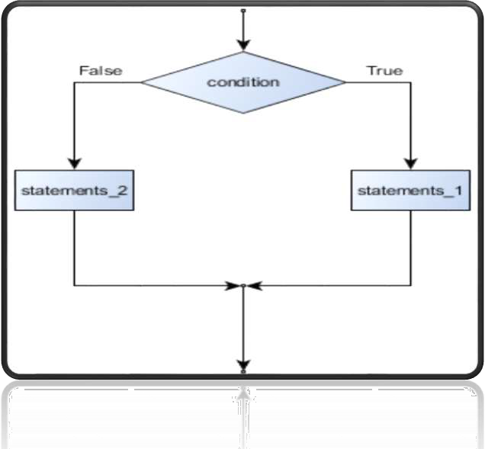

Slide 23
Example:
Write a program that inputs a number and finds whether it is even or odd using if-else structure. #Include<iostream.H>
#Include <conio.H>
Void main()
{
Clrscr();

Slide 24
Int n;
Cout<<’’enter a number:’’; cin>>n;
If(n%2==0)
Cout<<n<<’’is even.’’;
Else
Cout<<n<<’’is odd.’’;
Getch();
}

Slide 25
Output: Enter a number: 10 10 is even.

Slide 26
SWITCH STATEMENT
The switch statement is another conditional structure. It is a good alternative of nested if- else.

Slide 27
It can be used easily when there are many choices available and only one should be executed. Note : only evaluates on equality

Slide 28
Syntax:
Switch(expression_variable)
{
(Integer or character constant)
Case constant 1: statement(s); break;
Case constant 2:

Slide 29
Statement(s);
break;
.
.
Case constant n:
Statement(s);
break;
Default:
Statement(s);
break;

Slide 30
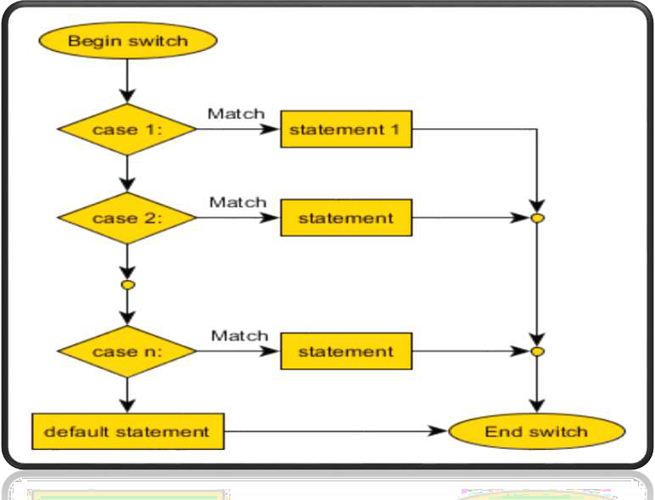

Slide 31
Write a program that inputs number of week’s day and display the name of the day. #Include<iostream.H> #include<conio.H>
Void main()

Slide 32
{
Clrscr (); int n;
Cout << “enter a number of a
Weekday.”; Cin>>n; switch (n)
{
Case 1:
Cout << “friday”; break;

Slide 33
Case 1:
Cout << “friday”; break;
Case 2:
Cout << “saturday”; break;
Case 3:
Cout << “sunday”; break;

Slide 34
Case 4:
Cout<< “monday”; break;
Case 5:
Cout<< “tuesday”; break;
Case 6:
Cout<<“wednesday”; break;

Slide 35
case 7:
cout<< “thursday”;
break;
default:
cout<< “invalid number”;
}
getch ();
}

Slide 36


